Slide 1
Cisco Unity Connection
Custom Roles
February 2016

Slide 2
Notice
The information in this presentation is provided under Non-Disclosure agreement and should be treated as Cisco Confidential. Under no circumstances is this information to be shared further without the express consent of Cisco.
Any roadmap item is subject to change at the sole discretion of Cisco, and Cisco will have no liability for delay in the delivery or failure to deliver any of the products or features set forth in this document.

Slide 3
Agenda
Introduction
What's new
Configuration
Demo
Troubleshooting

Slide 4
Introduction
Roles are used to control access to the system. It is a set of privileges which govern the operations allowed to a user.
Current Behavior:
Roles come pre-configured with Unity Connection (e.g. System Administrator, User Administrator, Technician etc.)
Pre-Configured roles are called System Roles
System Roles cannot be created, modified and deleted
System Administrator can assign/un-assign roles to the users

Slide 5
What’ New
Introducing Custom Roles (Unity Connection 11.5 release)
Allows System Administrator to
Dynamically create new roles
Manage Access Control based on the business requirement.
Privileges can be assigned/unassigned to custom roles
Custom roles can be assigned/unassigned to the users
Note: Only System Administrator can create/modify/delete custom roles

Slide 6
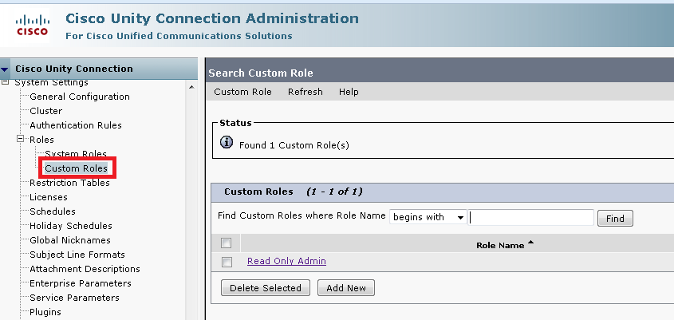
What’s new on CUCA
Administrator can create custom roles on CUCA
Go to: System Settings -> Roles -> Custom Roles

Slide 7
Configuration
Login to Unity Connection as “System Administrator”
Create New Custom Role. Define “Role Name” and assign “Privileges”
Assign New Custom Role to the User

Slide 8
Privileges Mapping with CUCA Operations
For Accessibility, Privilege List on Custom Roles page is mapped with the Operations listed on the left hand side tree on CUCA.
Either a privilege or a group of privilege is required to perform the operation.
Note :- Refer to Roles Guide for detailed information about the Privileges Mapping with the CUCA Operations.

Slide 9
Demo

Slide 10
Demo Scenarios
Read Only Admin
Custom Admin for System Settings
Modify Read Only Admin to grant Call Handler access.

Slide 11
Scenario 1: Create “Read Only” Custom Role
Go to: System Settings -> Roles-> Custom Roles
Creates “ReadOnly_Role” with following privilege:
“Read Access To System Configuration Data - Read Access”
Assign “ReadOnly_Role” to “ReadOnlyAdminUser”.
ReadOnlyAdminUser :
Will be able to view Connection Configuration Settings
Will not be able to modify Configuration Settings
Note: Privilege “Read Access To System Configuration Data - Read Access” should be associated with each custom role for view access.

Slide 12
Scenario 2: Create Custom Role to manage System settings
System Administrator creates “SysSettings_Role” with following privileges:
“Read Access To System Configuration Data - Read Access”
“System Settings - Full Access”
“System Settings: Advanced - Full Access”
System Administrator assigns “SysSettings_Role” to “SystemSettingsAdminUser”.
SystemSettingsAdminUser :
will be able to manage System settings
will not be able to manage other settings

Slide 13
Scenario 3: Modify Privilege of Read Only Custom Role
Assign “Call Management: Directory Handlers - Full Access” privilege to “ReadOnly_Role” Custom role and assign this role to a user.
User will be able to modify Call management
Un-assign “Call Management: Directory Handlers - Full Access” privilege from the role.
User will not be able to modify Call management

Slide 14
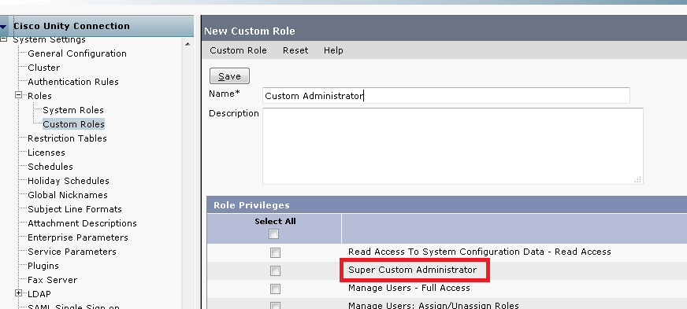
FedRamp Requirement
Administrator Hierarchy:
Enable fedRAMP mode using CLI 'utils fedRAMP enable‘
Once cuc comes in fedRAMP mode new privilege “Super Custom Administrator” is introduced to provide administrator hierarchy.

Slide 15
FedRamp Requirement
Administrator Hierarchy:
Administrators are divided into 3 Levels of hierarchy.
Two types of Administrator can be created using custom roles :
Super Custom Administrator
Custom Administrator
Super Custom Administrator1
Custom Administrator1
Custom
Administrator2
Custom Administrator3
Super Custom Administrator2
System Administrator

Slide 16
FedRamp Requirement
System Administrator:
Default Administrator
Full access to the system and have all privileges
Cannot be modified by user having Custom Role
Super Custom Administrator:
Governed by “Super Custom Administrator” privilege
Any custom Administrator having this privilege, can only be modified by System Administrator or another custom admin with the same privilege.
Restricted access to the system based on privileges it has
Custom Administrator:
A custom role not having “Super Custom Administrator” privilege
Can be modified by another custom admin
Restricted access to the system based on list of privileges it has

Slide 17
FedRamp Requirement
 | Create/Update/Delete Custom Roles | Create/Update/Delete Users and User Templates
System Administrator (System Role) | ✓ | ✓
Super Custom Administrator (Custom Role) | ✗ | ✓ (Except Users having System Roles)
Custom Administrator (Custom Role) | ✗ | ✓ (Except Users having System Roles/ Super Custom Administrator Role)
Note:
Above Matrix of hierarchy holds true when both custom admin have “Manage Users” and/or “Manage Templates” privilege.
User having both System and Custom roles will be considered as System Role user.

Slide 18
Super Custom Administrator
Create “SuperCustomAdministrator_Role” with following privileges:
“Super Custom Administrator”
“Read Access To System Configuration Data - Read Access”
“Manage Users - Full Access”
“Manage Users: Call Handlers - Full Access”
Assign “SuperCustomAdministrator_Role” to a user named “SuperCustomAdministratorUser”
SuperCustomAdministratorUser:
Will be able to manage users
Will be able to assign custom roles to users
Will not be able to modify Configuration Settings
Will not able to modify user having System role

Slide 19
Custom Administrator
Create “CustomAdministrator_Role” with following privileges:
“Read Access To System Configuration Data - Read Access”
“Manage Users - Full Access”
“Manage Users: Call Handlers - Full Access”
System and Super Custom Administrator can assign “CustomAdministrator_Role” to a user named “CustomAdministratorUser”.
CustomAdministratorUser:
Will be able to manage users
Will not be able to modify Configuration Settings
Will not able to modify user having System role or role having privilege as “Super Custom Administrator”.

Slide 20
Troubleshooting

Slide 21
Troubleshooting
Problem Scenarios with Solution:
Custom Role create/update/delete failure:
If Custom Role create/update/delete action fails, then check that the login user has System Administrator role.
Role Assignment/Un-assignment failure:
If Custom Role assign/un-assign action fails, then first check that user has privilege “Manage Users: Assign/Unassign Roles” after that login user role:-
Custom Administrator - If Login user is Custom Admin, then it cannot assign/un-assign System role or role having privilege “Super Custom Administrator” to a user.
Super Custom Administrator - If Login user is Custom Admin, then it cannot assign/un-assign System role to a user.

Slide 22
Troubleshooting
Problem Scenarios with Solution:
User create/update/delete failure:
If a User create/update/delete action fails, then first check that user has privileges “Manage Users - Full Access” and “Manage Users: Call Handlers - Full Access” after that login user role:-
Custom Administrator - If Login user is Custom Admin, then it cannot perform operations on a user having System role or role having privilege Super Custom Administrator.
Super Custom Administrator - If Login user is Custom Admin, then it cannot perform operations on a user having System role.
Annotated logs wiki: https://wiki.cisco.com/display/UNITYTRANS/Annotated+diagnostics+for+Custom+Roles

Slide 23
Future Work
Support of REST API to create/modify Custom roles.
Bulk Edit of Users via Custom Administrator based on list of privileges.

Slide 24
Reference
Cisco Unity Connection Administration Guide:
https://www-author.cisco.com/c/en/us/td/docs/voice_ip_comm/connection/11x/administration/guide/b_cucsag/b_cucsag_chapter_010101.html#id_17479

Slide 25
Thank You

