Slide 1
Branding Customizations in Unity Connection
February 2018

Slide 2
Notice
The information in this presentation is provided under Non-Disclosure agreement and should be treated as Cisco Confidential. Under no circumstances is this information to be shared further without the express consent of Cisco.
Any roadmap item is subject to change at the sole discretion of Cisco, and Cisco will have no liability for delay in the delivery or failure to deliver any of the products or features set forth in this document.

Slide 3
Agenda
Introduction
Overview of Changes
Branding Applicability
Skinning Applicability
Zip File Structure
Properties File Content
Enabling Branding Customizations
Disabling Branding Customizations
Demo
Troubleshooting
References

Slide 4
Introduction
Branding Customization is the process involved in personalizing the look and feel of Unity Connection based on organizational requirements.
This feature allows the administrator to upload custom branding (like company logo) and skinning (background/font colors etc) configuration to suit specific asks.
This configuration gets applied to following web application on Cisco Unity Connection,
Cisco Unity Connection Administration
Cisco Personal Communication Assistant
Web Inbox
Mobile and Mini Inbox
Notes:
Connection Mini Web Inbox is a player that allows user to play the voice messages over computer or mobile devices/tablets. With Connection Mini Web Inbox, user can play, reply, reply all, forward, or delete the voice messages using a phone or a computer. To access the Mini Web Inbox, you must click the links as displayed in the email notification

Slide 5
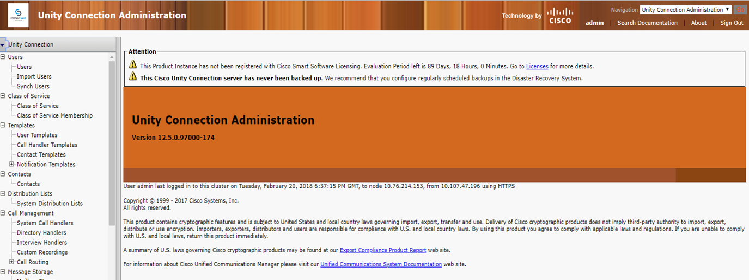
Overview of Changes
Note: The branding and skinning custom configurations are applied in Unity Connection via a zip file containing details of required customizations in specified format., “branding.zip”

Slide 6
Branding Applicability
Branding is applicable on elements highlighted below.
The items in GREEN are static changes and will be applied automatically once branding is enabled.
The items in RED are configurable changes and will be derived from the ZIP file.
Notes:
Note: Although these changes persist but exceptionally the Brand logo on the top left corner is customizable

Slide 7
Branding Applicability
Static Changes
Cisco keyword is removed from
Header frame
Splash screen
Drop down on the top right corner
New logo is introduced on the top right corner,
Configurable Changes
Brand Logo on the top left corner (configurable, desired logo can be provided in zip)

Slide 8
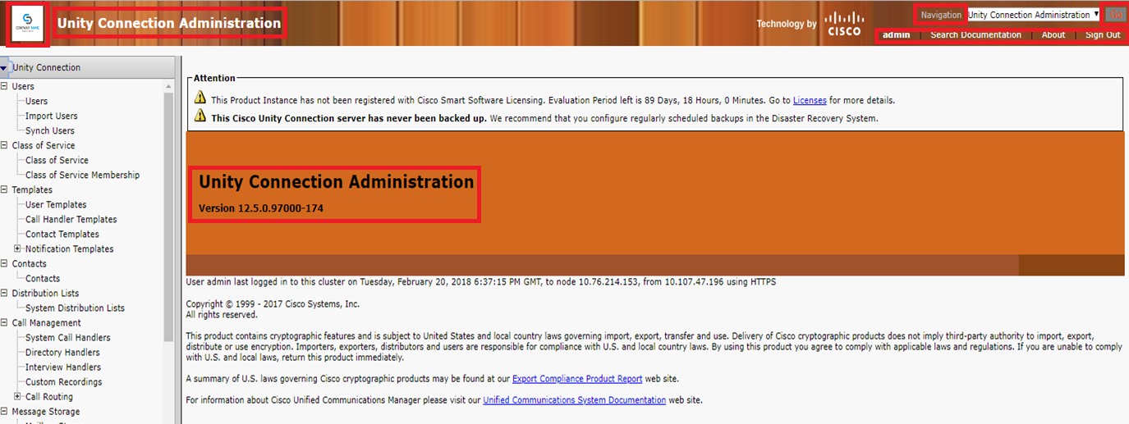
Skinning Applicability
Skinning is applicable on elements highlighted below.
All skinning changes are customizable and derived from the zip file.
1
2
3
4
5
6
8
7
9
10

Slide 9
Zip File Structure
To enable branding first we need to create a pre-defined folder structure with specified files and club it into a zip file namely, “branding.zip”
FOLDER STRUCTURE
Branding(folder) ccmadmin (folder) BrandingProperties.properties (file) brandingHeaderBegLTR.gif (652*1 pixel image) brandingHeaderBegRTL.gif (652*1 pixel image) brandingHeaderEndLTR.gif (652*1 pixel image) brandingHeaderEndRTL.gif (652*1 pixel image) brandingHeaderMidLTR.gif (652*1 pixel image) brandingHeaderMidRTL.gif (652*1 pixel image) ciscoLogo12pxMargin.gif (44*44 pixel image) branding_logo.png (44*25 pixel image)
Note – The properties file is a key-value pair for various colour configurations, and the images are for logo and background. (Discussed further in details)
1

Slide 10
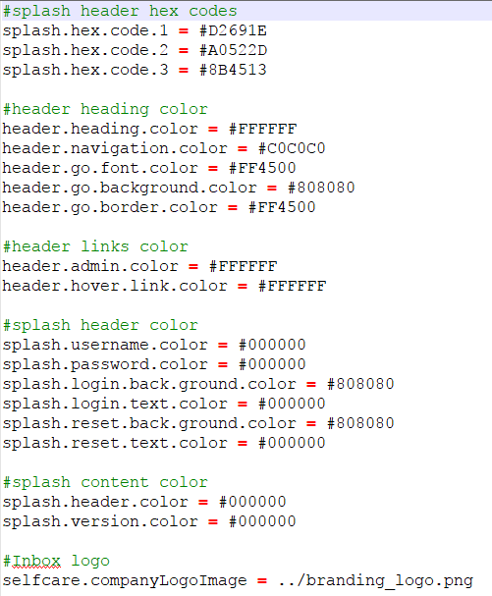
Properties File Content
To enable branding first we need to create a pre-defined folder structure with specified files and club it into a zip file namely, “branding.zip”
2

Slide 11
Item | Description | Branding Edits
1 | Company Logo | ciscoLogo12pxMargin.gif (44*44 pixels)
2 | Header font color | heading.heading.color
3 | Header Background | brandingHeader.gif (652*1 pixel) or set of six images (shown in folder structure)
4 | User text (for example, 'admin') Search, About and Login text | header.admin.color header.hover.link.color
5 | Navigation text | header.navigation.color
6 | Go button | header.go.font.color header.go.background.color header.go.border.color
7 | Splash header Font color Splash System Version color | splash.header.color splash.version.color
8 | Banner | splash.hex.code.1
9 | Bottom background color – left | splash.hex.code.2
10 | Bottom background color – right | splash.hexcode.3

Slide 12
Enabling Branding Customizations
To enable branding first we need to create a pre-defined folder structure with specified files and club it into a zip file namely, “branding.zip”
Once we have the branding.zip file handy, follow these steps to enable branding,
Log in to Cisco Unified OS Administration
Choose Software Upgrades -> Branding
Browse to your remote server and select the branding.zip file
Click Upload File
Click Enable Branding
Restart Tomcat
Note: On cluster setup, Enable Branding on each node separately

Slide 13
Disabling Branding Customizations
Follow these steps to disable branding,
Log in to Cisco Unified OS Administration
Choose Software Upgrades -> Branding
Click Disable Branding
Restart Tomcat
Note: On cluster setup, Enable Branding on each node separately

Slide 14
Demo
Scenario 1: Enable branding with sample branding.zip file
Scenario 2: Customize company logo and Cisco Unity Connection header font color

Slide 15
Troubleshooting
Scenario: If Branding customization is not appeared on the Cisco Unity Connection interfaces.
Action: If Branding is not appeared on Cisco Unity Connection interfaces, verify the following:
Make sure the Branding is enabled on Cisco Unity Connection. To check the status execute "utils branding status" CLI command.
If Branding is enabled, you must restart the tomcat services.
Make sure Branding.zip file is successfully uploaded and is structured as per the Branding Customizations document provided.

Slide 16
References
System Administration Guide for Cisco Unity Connection 12.x: https://www.cisco.com/c/en/us/td/docs/voice_ip_comm/connection/12x/administration/guide/b_12xcucsag.html
Cisco Unified Communications Operating System Administration Guide for Cisco Unity Connection 12.x: https://www.cisco.com/c/en/us/td/docs/voice_ip_comm/connection/12x/os_administration/b_12xcucosagx.html
Annotated Logs Wiki: https://ccbu-wiki.cisco.com/pages/viewpage.action?pageId=128749331

Slide 17
Thank You

