Slide 1
Rest API Support for Cisco Smart Software Licensing
October 2017

Slide 2
Notice
The information in this presentation is provided under Non-Disclosure agreement and should be treated as Cisco Confidential. Under no circumstances is this information to be shared further without the express consent of Cisco.
Any roadmap item is subject to change at the sole discretion of Cisco, and Cisco will have no liability for delay in the delivery or failure to deliver any of the products or features set forth in this document.

Slide 3
Agenda
Introduction
What’s New
Transport Setting API
Register API
Reregister API
Deregister API
Renew Authorization API
Renew Registration API
Licensing Details
Get License Data for STT
References

Slide 4
Introduction
Unity Connection provides a simple and enhanced way of licensing, Cisco Smart Software Licensing to use the various features of Unity Connection. Using Cisco Smart Software Licensing, you can manage all the licenses associated with an organization through Cisco Smart Software Manager (CSSM) or Cisco Smart Software Manager satellite.
Unity Connection must be registered with the CSSM or satellite to use various licensed feature.
For performing various operations of Cisco Smart Software Licensing, Unity Connection provides following interfaces:
User Interface of Cisco Unity Connection Administration
Command Line Interface (CLI)

Slide 5
What’s New
Unity Connection 12.5(1) or later provides the REST API support to use the Cisco Smart Software Licensing.
Below operations of Cisco Smart Software Licensing can be performed using REST API:
Transport Setting
Register
Reregister
Deregister
Renew Authorization and Renew Registration
License Details
Get STT License Data

Slide 6
Transport Setting API
Transport Setting provides the options through which Unity Connection communicates with the Cisco Smart Software Manager (CSSM) or Cisco Smart Software Manager satellite.
GET and PUT operations are supported for transport settings
Resource URI: https://<connectionserver>/vmrest/smartlicense/transportsettings
Parameters that constitutes request and response body :
TransportMode
TransportUrl
HttpPort
HttpHost

Slide 7
GET Example
Request URI:
https://<connectionserver>/vmrest/smartlicense/transportsettings
GET Response:
<TransportSetting>
<transportMode>0</transportMode>
<transportUrl>https://tools.cisco.com/its/service/……..</transportUrl>
<httpHost>0</httpHost>
<httpPort>0</httpPort>
</TransportSetting>
Notes:
TransportMode: 0 for direct transport setting, 1 for satellite, 2 for https proxy server.
TransportURL: URL of the direct setting or satellite.
HttpHost: Hostname or IP of the proxy server.
HttpPort: The port that is used to communicate with CSSM.
For more information on the different data fields of request body or request response, see Cisco Unity Connection Provisioning Interface (CUPI) API – Smart Licensing
at https://www.cisco.com/c/en/us/td/docs/voice_ip_comm/connection/DocWiki/APIs/guide/b_Cisco_Unity_Connection_APIs.html

Slide 8
PUT Example
Request URI:
https://<connectionserver>/vmrest/smartlicense/transportsettings
Request Body:
<TransportSetting>
<transportMode>0</transportMode>
<transportUrl>https://tools.cisco.com/its/service/……..</transportUrl>
<httpHost>0</httpHost>
<httpPort>0</httpPort>
</TransportSetting>
Response Code:
200 OK – for successful.

Slide 9
Register API
Using this API, you can register the product with CSSM or satellite. For registration, you need a registration token from CSSM or satellite.
PUT operation is supported to register the product
Request URI:
https://<connection-server>/vmrest/smartlicense/register
Request Body:
<RegisterDetails> <token>NDJiMjI0YTAtMjc0MC00NWNmLTllODAtNDBkMTFi</token> <force> false</force> </RegisterDetails>
Response Code:
200 OK – for successful.
Notes:
Token: Token is required to register the product with CSSM or satellite. The token is created on CSSM or satellite.
Force: False for registering the product, true for reregistering the product.
For more information on the different data fields of request body or request response, see Cisco Unity Connection Provisioning Interface (CUPI) API – Smart Licensing
at https://www.cisco.com/c/en/us/td/docs/voice_ip_comm/connection/DocWiki/APIs/guide/b_Cisco_Unity_Connection_APIs.html

Slide 10
Reregister API
Using this API, you can reregister the product with CSSM or satellite. For this “force” field in request body must be true.
PUT operation is supported to register the product
Request URI:
https://<connection-server>/vmrest/smartlicense/register
Request Body:
<RegisterDetails> <token> NDJiMjI0YTAtMjc0MC00NWNmLTllODAtNDBkMTF</token> <force> true</force> </RegisterDetails>
Response Code:
200 OK – for successful.
Notes:
For explanation of the different data fields of request body or request response, see Cisco Unity Connection Provisioning Interface (CUPI) API – Smart Licensing
at https://www.cisco.com/c/en/us/td/docs/voice_ip_comm/connection/DocWiki/APIs/guide/b_Cisco_Unity_Connection_APIs.html

Slide 11
Deregister API
Using this API, you can deregister the product from CSSM or satellite. All license entitlements used for the product are released back to its virtual account.
PUT operation is supported to deregister the product
Request URI:
https://<connection-server>/vmrest/smartlicense/deregister
Response Code:
200 OK – for successful.

Slide 12
Renew Authorization API
Using this API, you can renew the license authorization for the product with CSSM or satellite. However, the licenses are automatically authorized in every 30 days.
PUT operation is supported to renew the authorization of the product
Request URI:
https://<connection-server>/vmrest/smartlicense/renewAuth
Response Code:
200 OK – for successful.

Slide 13
Renew Registration API
Using this API, you can renew the registration of the product with CSSM or satellite. However, the registration of the product is automatically renewed in every six month.
PUT operation is supported to renew the registration of the product
Request URI:
https://<connection-server>/vmrest/smartlicense/renewID
Response Code:
200 OK – for successful.

Slide 14
Licensing Details
This API is used for listing all the licensing information of the product.
The licensing information comprises the following:
Registration details
Authorization details
License Usage
GET operation is supported to view the licensing information of the product
Request URI: https://<connection-server>/vmrest/smartlicense/licensedetails
Response Code: 200 OK – for successful.
Note: To get the latest licensing details of the product, you must renew the authorization of the product.

Slide 15
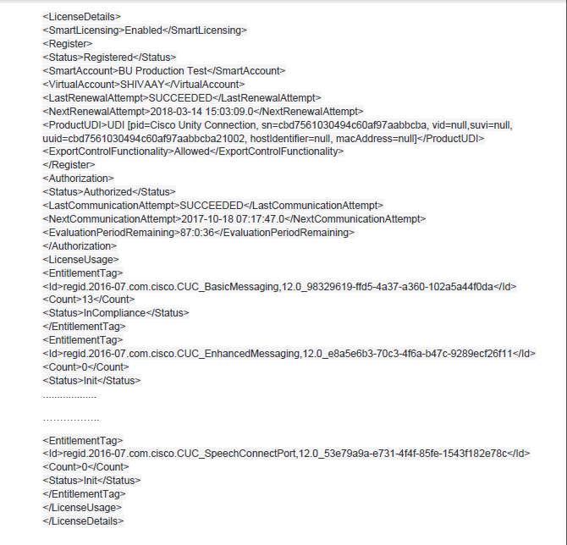
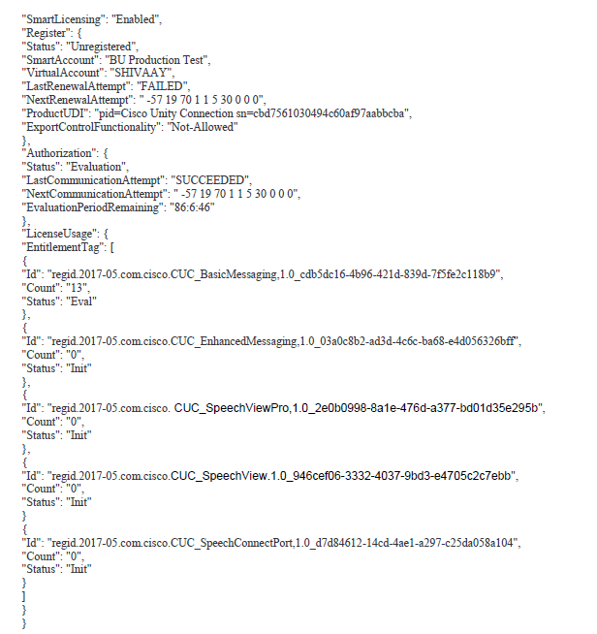
Cont….
GET Response
Note: The above response is in XML format. You can also get the response in JSON format. Example:
Notes:
For explanation of the different data fields of request body or request response, see Cisco Unity Connection Provisioning Interface (CUPI) API – Smart Licensing
at https://www.cisco.com/c/en/us/td/docs/voice_ip_comm/connection/DocWiki/APIs/guide/b_Cisco_Unity_Connection_APIs.html

Slide 16
Licensing Details (cont…)
License Usage provides license parameters and usage report based on the below deployment modes of Unity Connection:
Enterprise: This is the default mode of Unity Connection.
HCS: This mode comprises Hosted Collaboration Services.
HCS-LE: This mode comprises Hosted Collaboration Services -Large Enterprise.

Slide 17
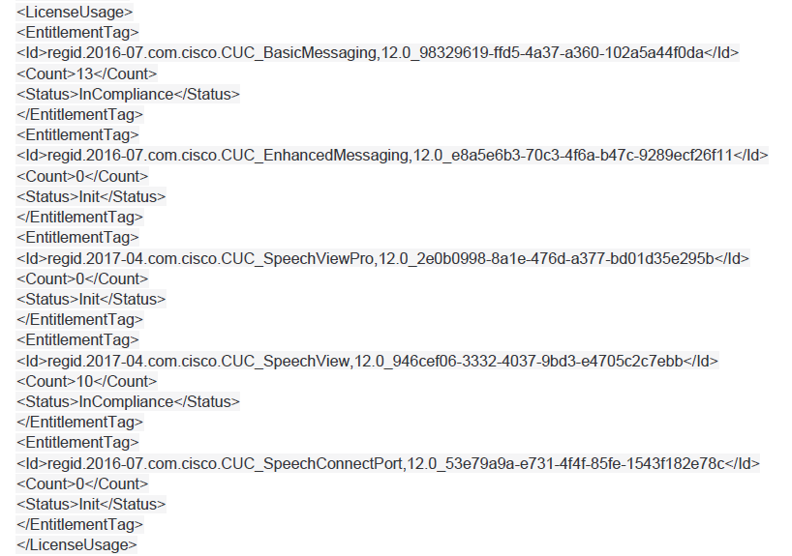
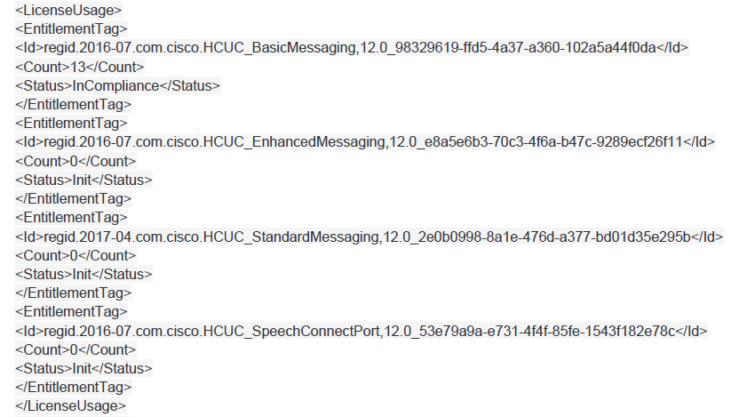
Example of License Usage
Enterprise Mode
HCS Mode

Slide 18
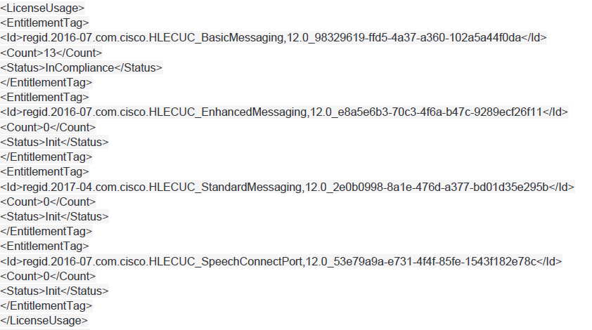
Cont…
HCS-LE Mode

Slide 19
Get License Data for STT
Using this API, you can acquire the SpeechView license data (Certificates and Voucher code) locally to the connection server from CSSM or satellite.
PUT operation is supported to get the license data for SpeechView
Request URI:
https://<connection-server>/vmrest/smartlicense/configurenuancecerts
Response Code:
200 OK – for successful.

Slide 20
Troubleshooting
For information on the troubleshooting scenarios of Cisco Smart Software Licensing, see Troubleshooting Guide for Cisco Unity Connection Release 12.x at https://www.cisco.com/c/en/us/td/docs/voice_ip_comm/connection/12x/troubleshooting/guide/b_12xcuctsg.html
For information on the Error Codes appeared on the REST API interface, see Cisco Unity Connection Provisioning Interface (CUPI) API – Smart Licensing at https://www.cisco.com/c/en/us/td/docs/voice_ip_comm/connection/DocWiki/APIs/guide/b_Cisco_Unity_Connection_APIs.html
Annotated Logs Wiki: https://ccbu-wiki.cisco.com/display/MESSAGING/Annotated+diagnostics+for+Smart+License+Rest+API

Slide 21
References
Install, Upgrade, and Maintenance Guide for Cisco Unity Connection Release 12.x
https://www.cisco.com/c/en/us/td/docs/voice_ip_comm/connection/12x/install_upgrade/guide/b_12xcuciumg.html
Documentation for Cisco Unity Connection API
https://www.cisco.com/c/en/us/td/docs/voice_ip_comm/connection/DocWiki/APIs/guide/b_Cisco_Unity_Connection_APIs.html

Slide 22
Thank You

